Slide 1
Shortest Path Kithay?
CS412 Final Project

Slide 2
Contents
Introducing the problem
Different approaches (main idea, design technique, theoretical cmplx)
Dijkstra
Bellman Ford
Randomized Shortest Path
Analysis (emperical complexity)
How using dataset OR Random graphs
X-axis: number of nodes
Y-axis: time OR steps

Slide 3
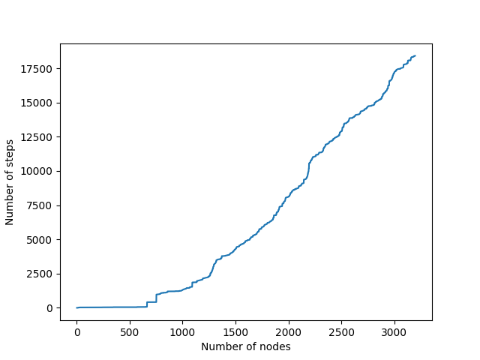
What is the shortest

